Slide 1


# Modeling the Relationship
# Between Energy and Weather Patterns
# For a Microgrid On Shinnecock Reservation
—---------------------------------------------------------------------------------------------------
Eliana Matsil
113462304
May 1, 2025

Slide 2
01
Background

Slide 3
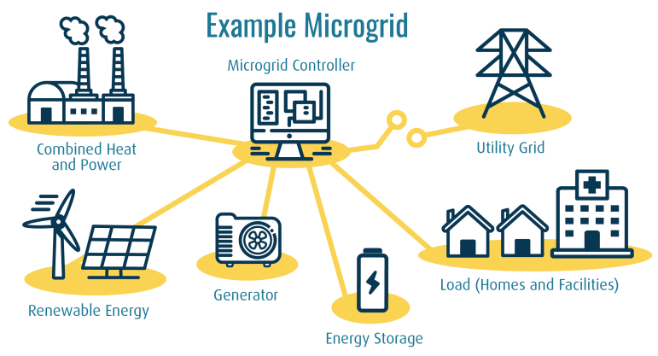
# Microgrids
—------------------------------------------------------------------------------------
Microgrid: A group of interconnected loads and distributed energy resources within clearly defined electrical boundaries that acts as a single controllable entity with respect to the grid.
Can operate in either grid-connected or in island mode, including entirely off-grid applications.
Key components:
Electricity Generation
(solar, wind, diesel/natural gas generator)
Energy Storage
(battery, hydrogen)
Control System
(balancing loads, managing energy flow)
Distributed Energy Resources!!!
Independence, resilience, decarbonization
[1, 2]

Slide 4
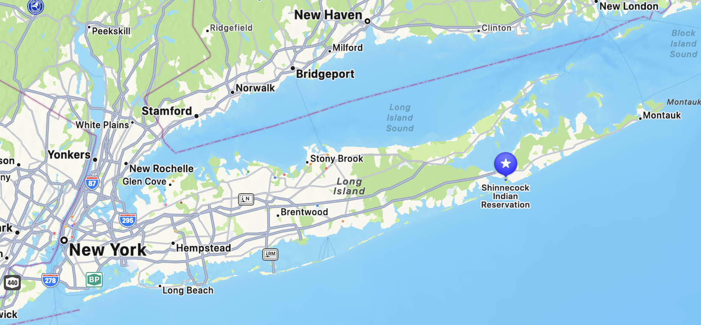


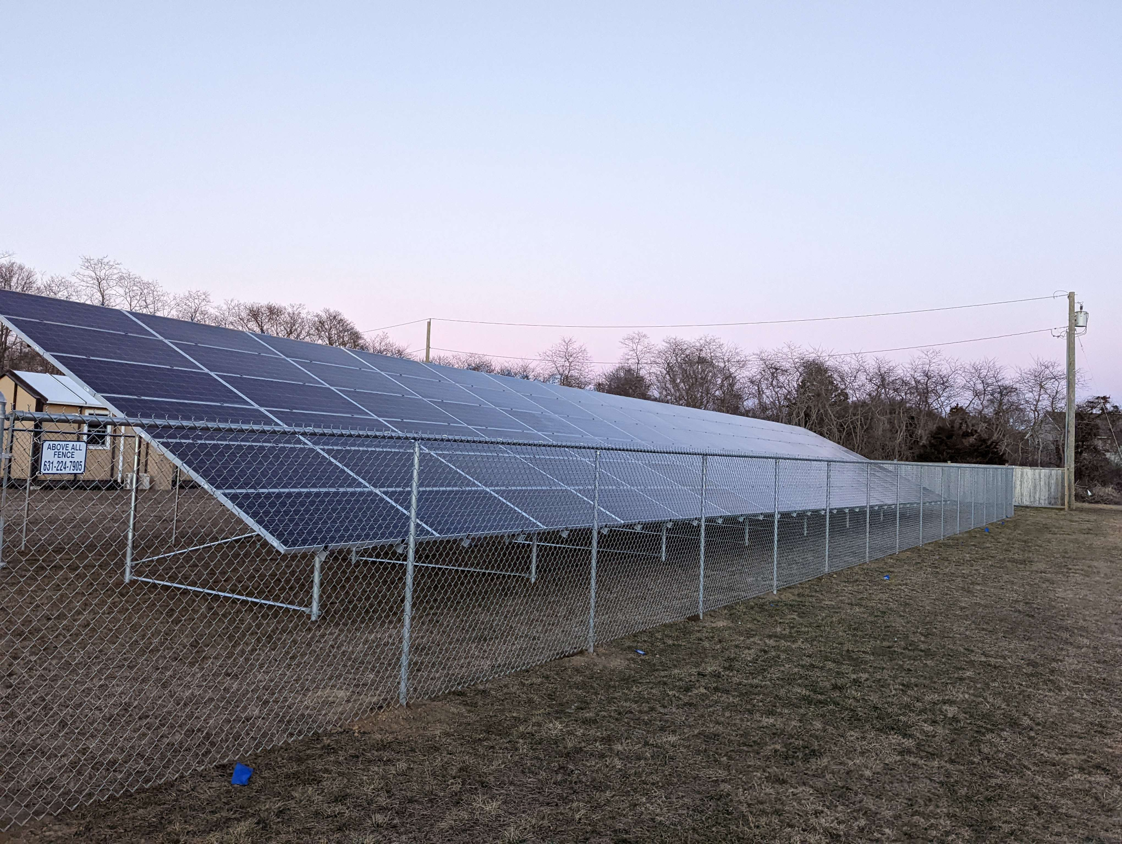
# Shinnecock Indian Nation
—------------------------------------------------------------------------------------
The Nation:
One of the oldest self-governing Indigenous tribes in North America, residing in Southampton on the eastern end of Long Island
Ayeu Transitional Housing:
Provides temporary, sustainable shelter to tribe members in need
Solar Power:
27 kW solar array on site
+ energy storage → microgrid
[3]

Slide 5
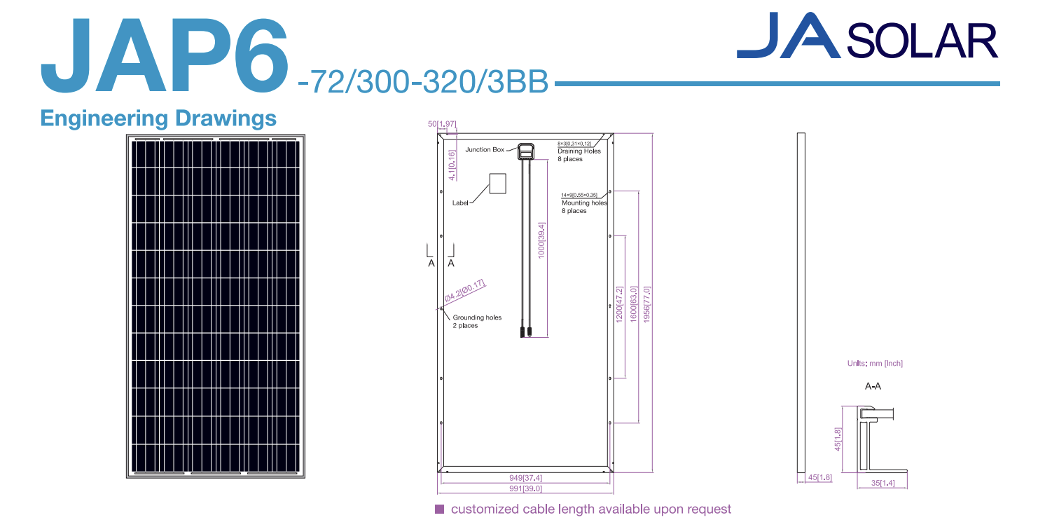
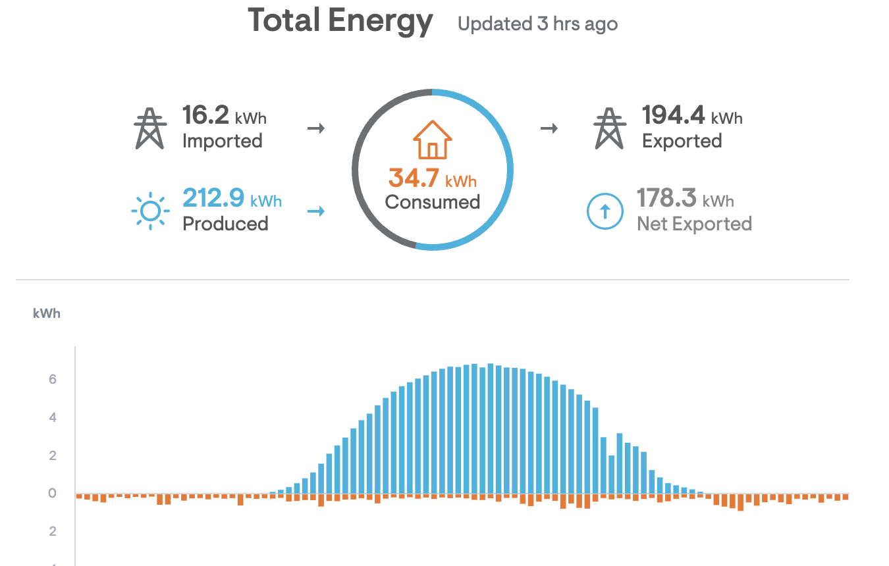
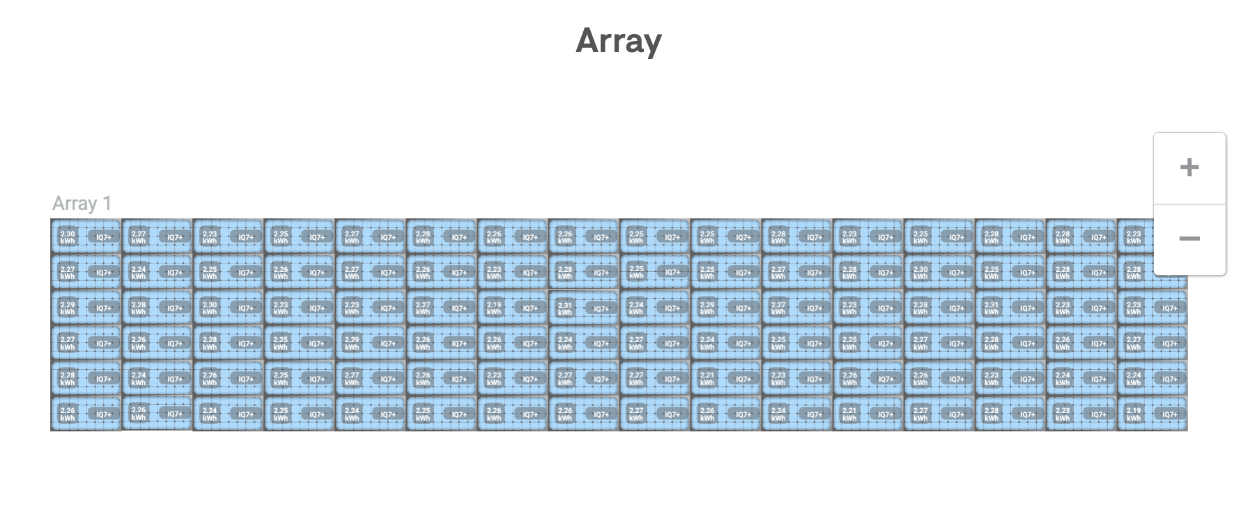
# Technology
------------------------------------------------------
JA Solar JAP6-72/315/3BB
Multicrystalline Silicon Modules
Enphase Enlighten
Access to generation and consumption data
Every 15-minutes
Insight into solar efficiency, identifying problems,
minimizing usage
Built into individual microinverters
[4, 5, 6]

Slide 6
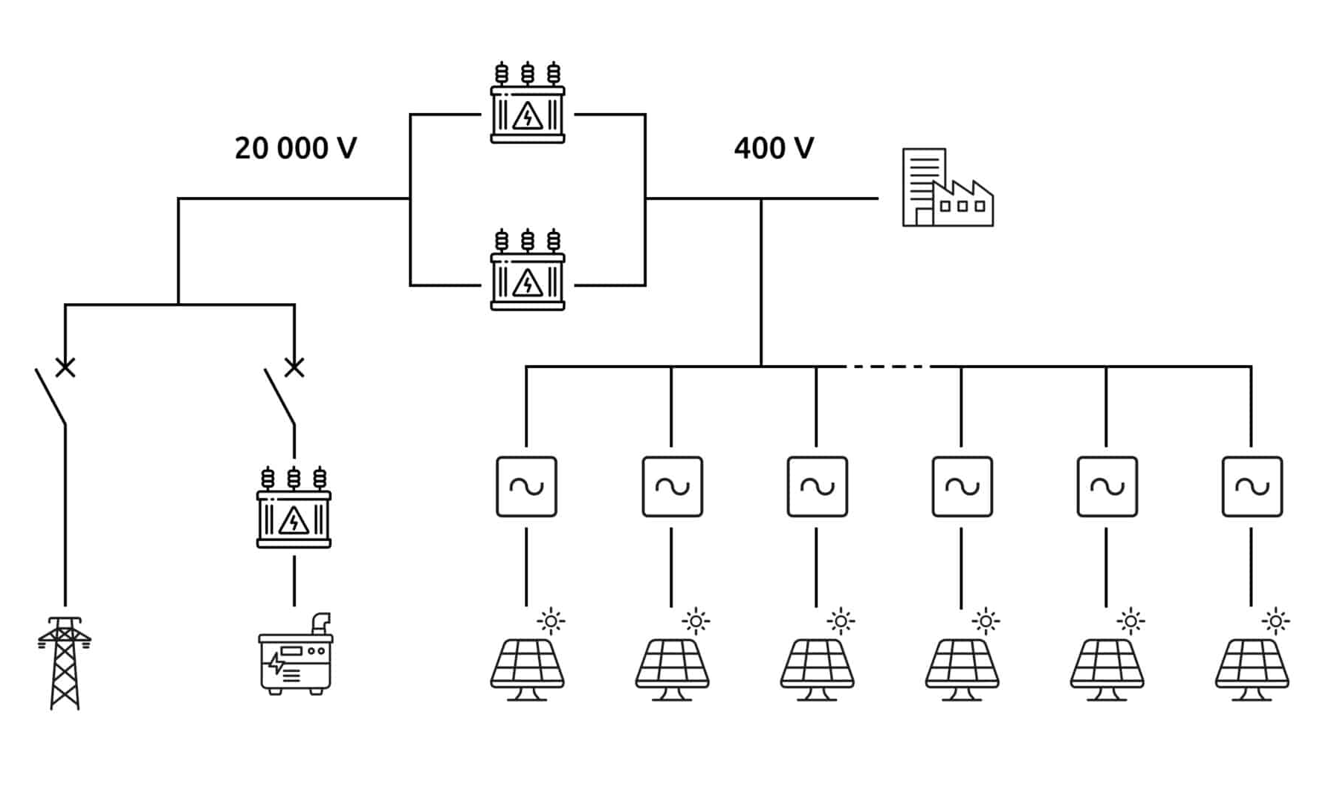
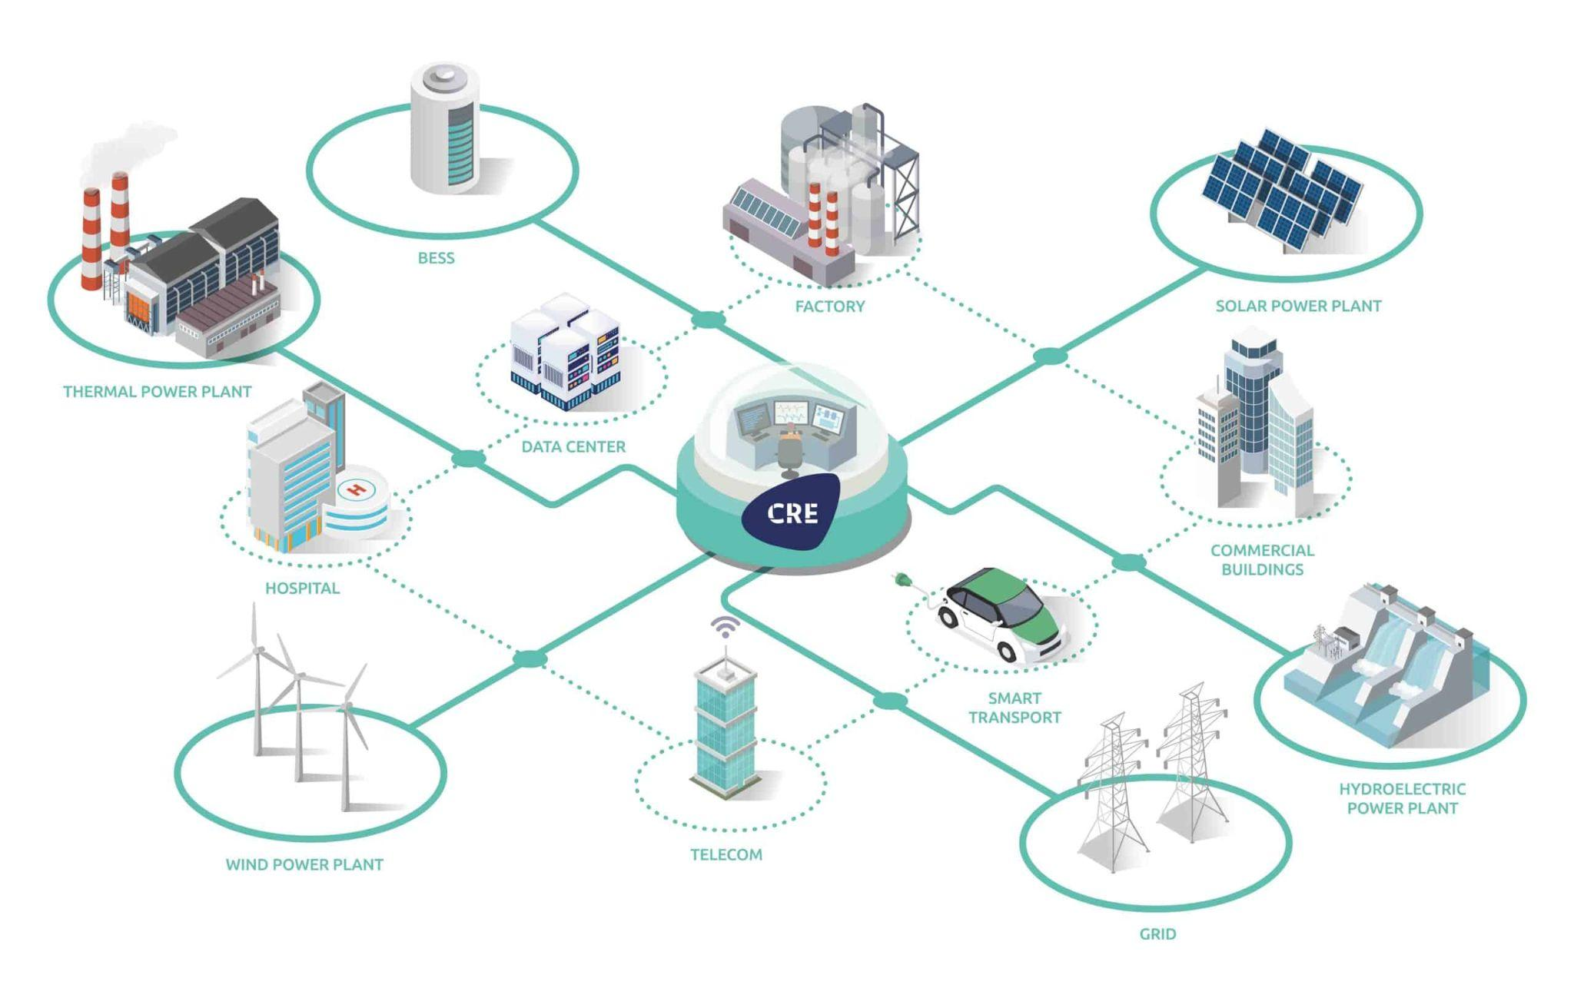
# Microgrid Implementation
—------------------------------------------------------------------------------------
Energy storage: batteries, hydrogen
Control system: Smart Energy Management System
Uses real-time data and advanced algorithms to control the operation of energy systems within a microgrid
Coordinates assets
Manages energy generation, distribution, and storage
Controls interaction with grid
Optimizes energy flow
Operates autonomously
Predictive & adaptive control
User interface & analytics
[1, 2]
[7, 8]

Slide 7

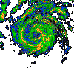


# Predictive & Adaptive Control
—------------------------------------------------------------------------------------
Using weather patterns to predict system behavior
Generating models based on real-time data
Energy Consumption vs. Temperature
Energy Production vs. Solar Irradiance
Implement appropriate control based on anticipation

Slide 8

# Example Scenario
—-------------------------------------------------------------------------------------
Receives a Severe Storm Warning
Reduces non-critical load (decorative lighting, EV charging stations)
Initiates full charging of all energy storage banks (using distributed sources and grid, if applicable)
Prepares to shift to backup sources
Using energy production prediction models, system recalculates anticipated energy availability
Using load prediction models, system monitors, optimizes, and prioritizes energy dispatch

Slide 9

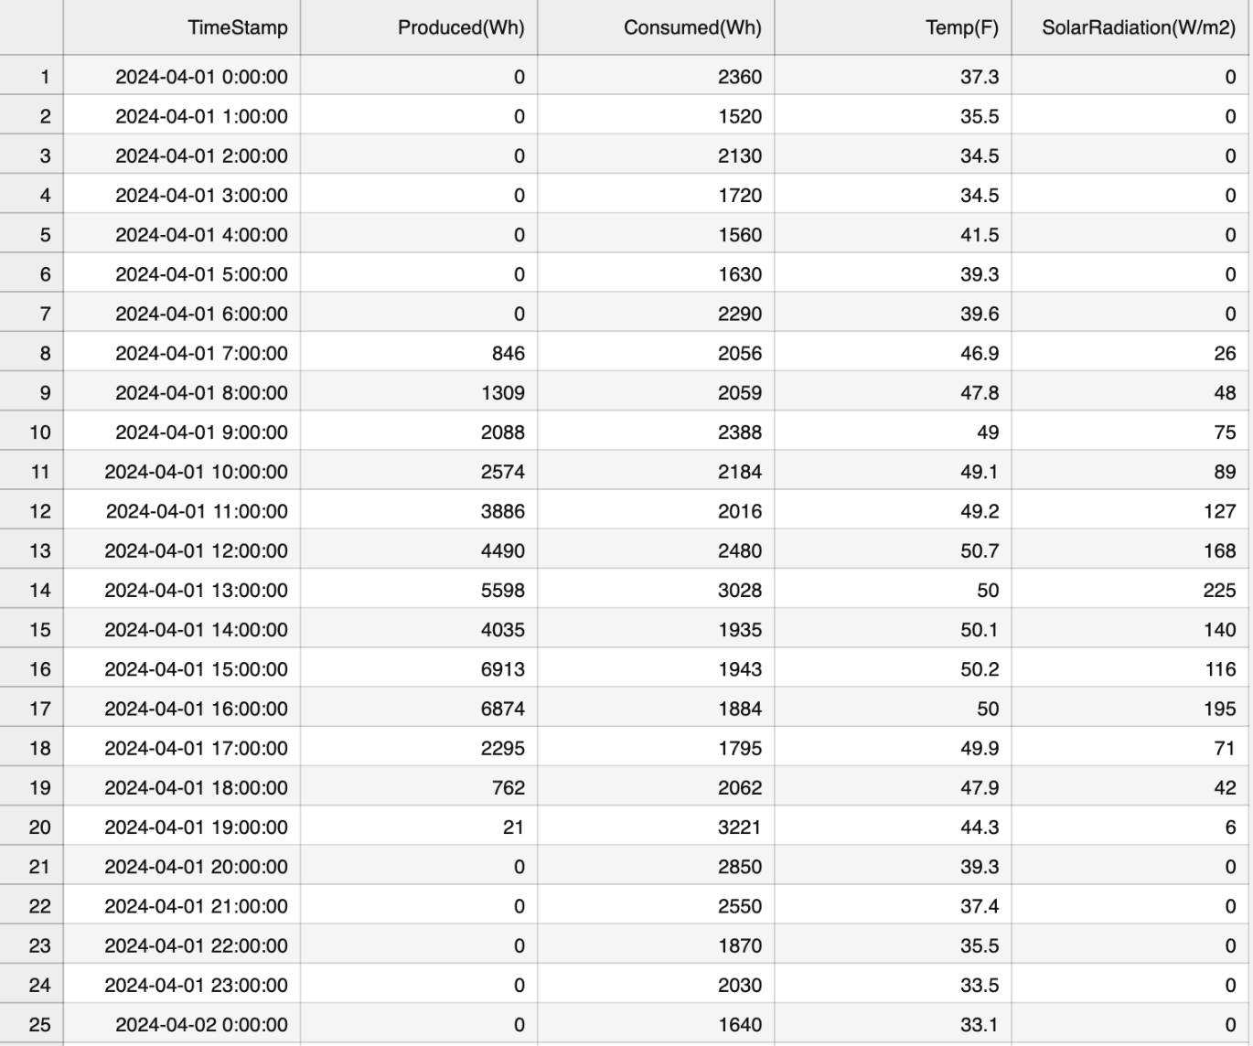
# Data Sourcing
—-------------------------------------------------------------------------------------
Energy Data
Enphase Enlighten
Weather Data
Visual Crossing
Global weather API including historical weather data, current conditions, up-to-date forecasts, and historical forecast information
April 2024 - March 2025
[5, 9]

Slide 10
02
Numerical Methods

Slide 11
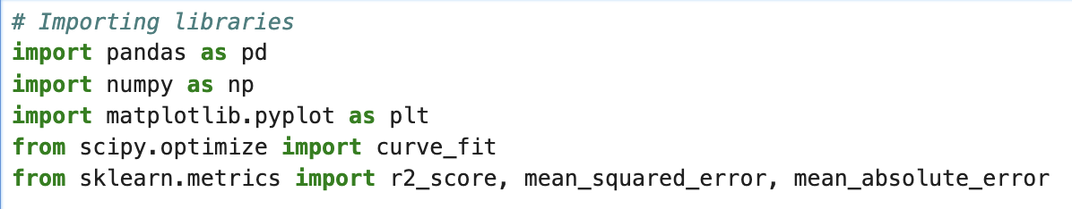
# Importing Libraries
—------------------------------------------------------------------------------------
Pandas - reading the csv file, converting timestamp to datetime
Numpy - np.exp(), np.inf, np.linspace
Matplotlib.pyplot - plotting results
Scipy.optimize & curve_fit - fitting models
Sklearn.metrics & r2_score, mean_squared_error, mean_absolute_error - evaluating model validity/error

Slide 12
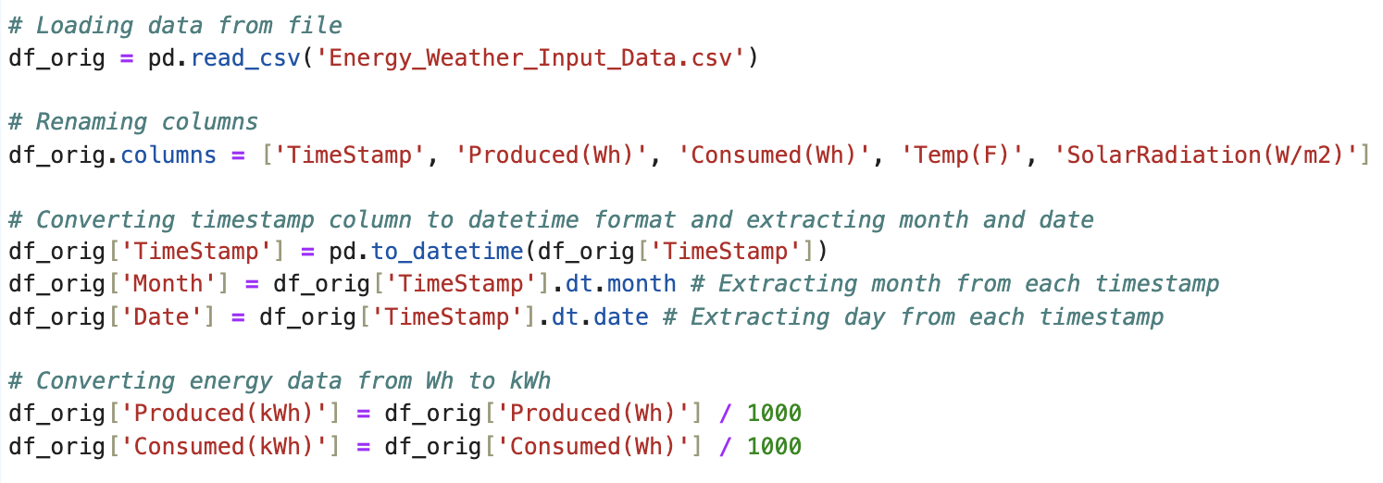
# Loading & Converting Data
—------------------------------------------------------------------------------------
Data stored in CSV:
Time (15-minute intervals)
Production (Wh)
Consumption (Wh)
Temperature (°F)
Solar Irradiance (W/m²)
Converting timestamp to datetime format in order to extract month
Converting energy units from Wh to kWh

Slide 13
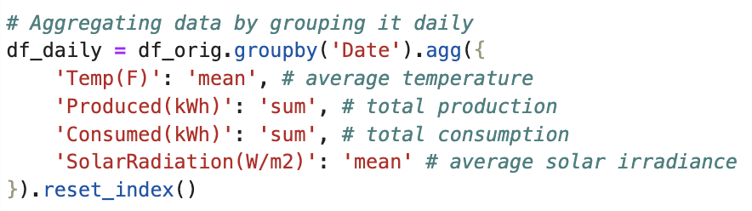
# Aggregating Data to Reduce Noise
—------------------------------------------------------------------------------------
Original raw data showed lots of noise
To reduce error:
Energy data was summed daily
Weather data was averaged daily

Slide 14
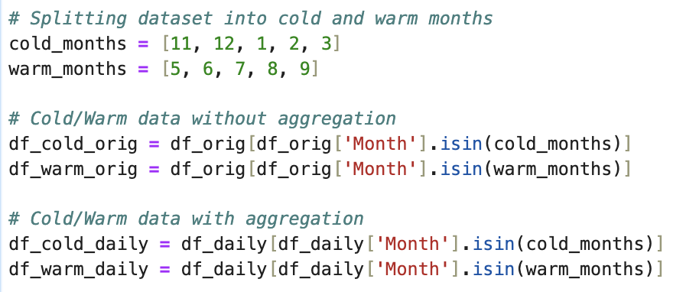
# Splitting Data into Cold/Warm Months
—------------------------------------------------------------------------------------
Exploring the potential for the data to be modeled more accurately based on time of year
Data split between:
Cold Months
(November - March)
Warm Months
(May - September)

Slide 15
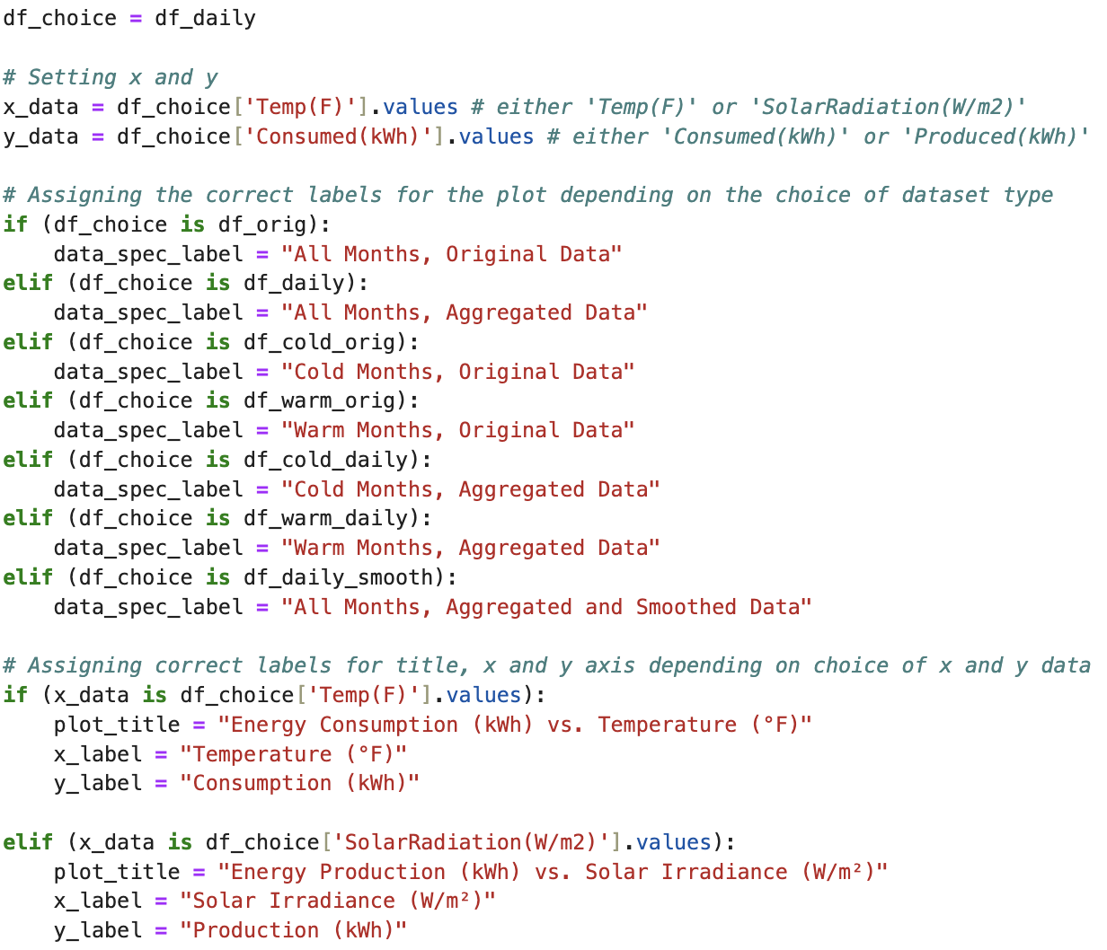
# Assigning Data Type & Plot Labels
—------------------------------------------------------------------------------------
User assigns a type of dataset
Original data
Aggregated data
Cold/warm data
User assigns x and y data
Cons (kWh) vs. Temp (°F)
Prod (kWh) vs. Solar (W/m²)
Plotting labels are customized based on choice of dataset

Slide 16
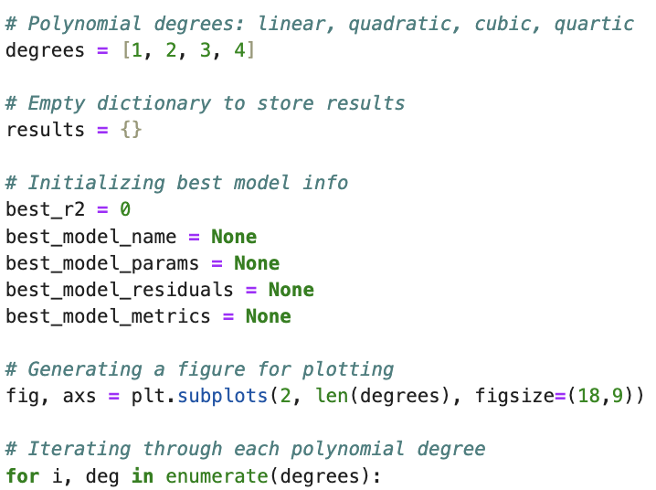
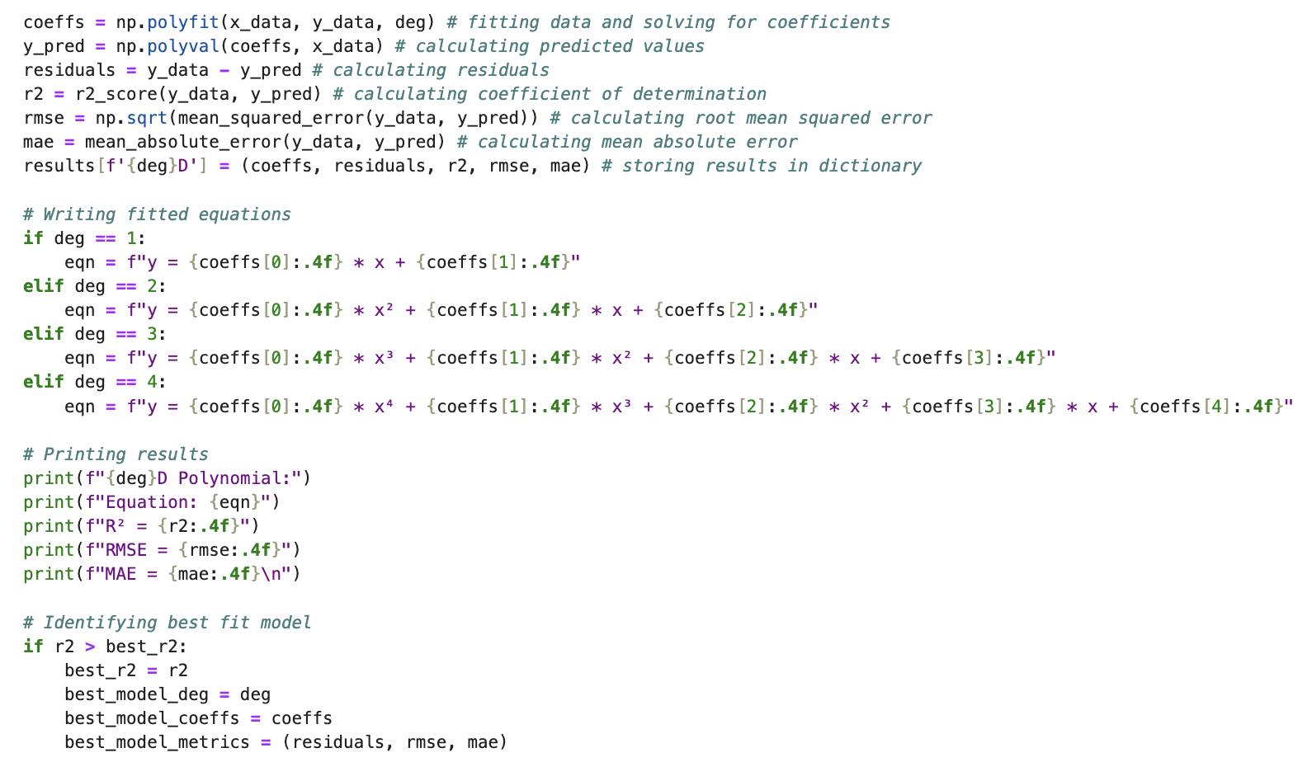
# Fitting
—------------------------------------------------------------------------------------
Models:
Linear
Quadratic
Cubic
Quartic
Exponential
Looping through each polynomial degree
Stored results in a dictionary
Stored results in a dictionary

Slide 17
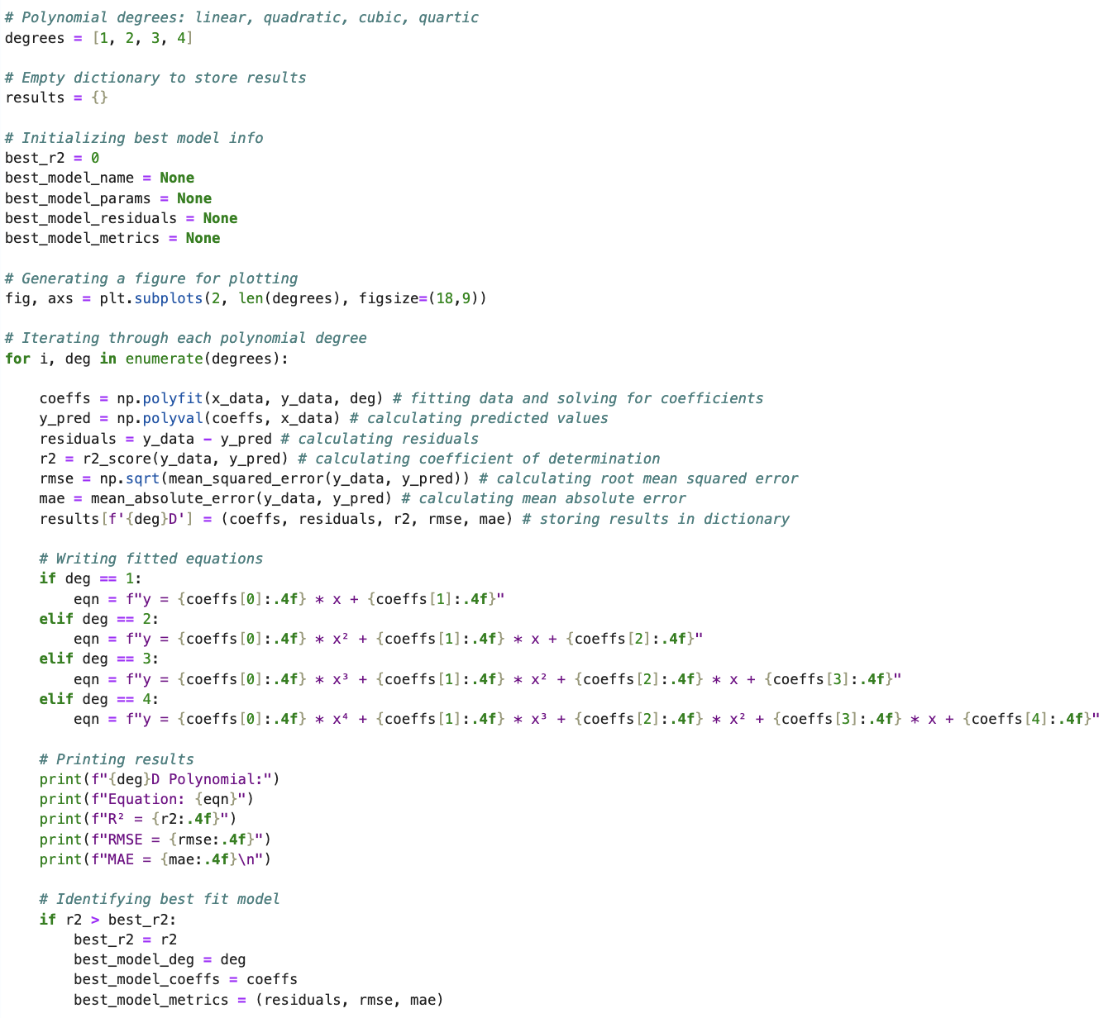
# Fitting Data to Polynomial Models
—------------------------------------------------------------------------------------
Looping through each polynomial degree
Linear
Quadratic
Cubic
Quartic
Fitting data to each model
Calculating predicted y-values and metrics
Storing results in a dictionary
Writing equations for each model
Printing results for each model
Identifying the best fit model based on the highest R2 Score

Slide 18
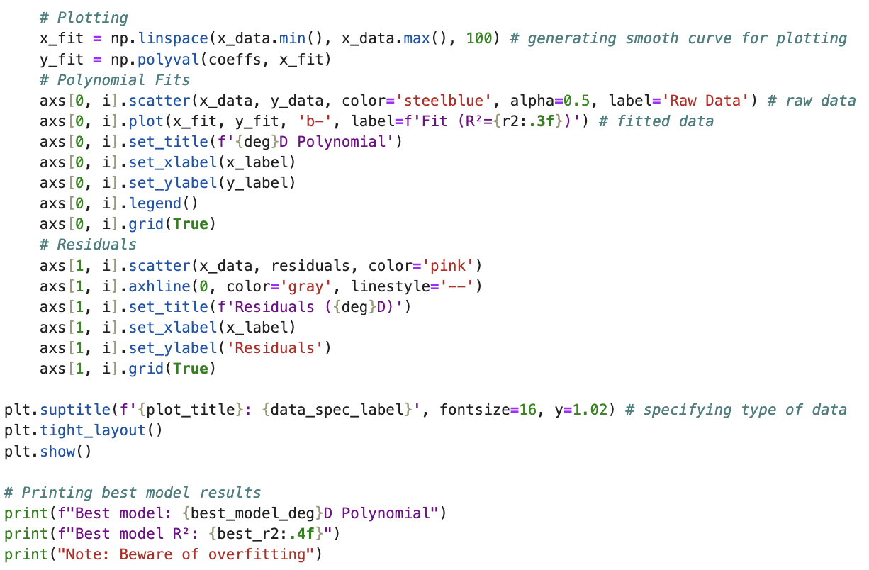
# Plotting & Printing Results
—------------------------------------------------------------------------------------
Looping through each polynomial degree
Generating smooth, fitted curves
Plotting fitted curves
Plotting residuals
Printing best fit model

Slide 19
03
Results

Slide 20
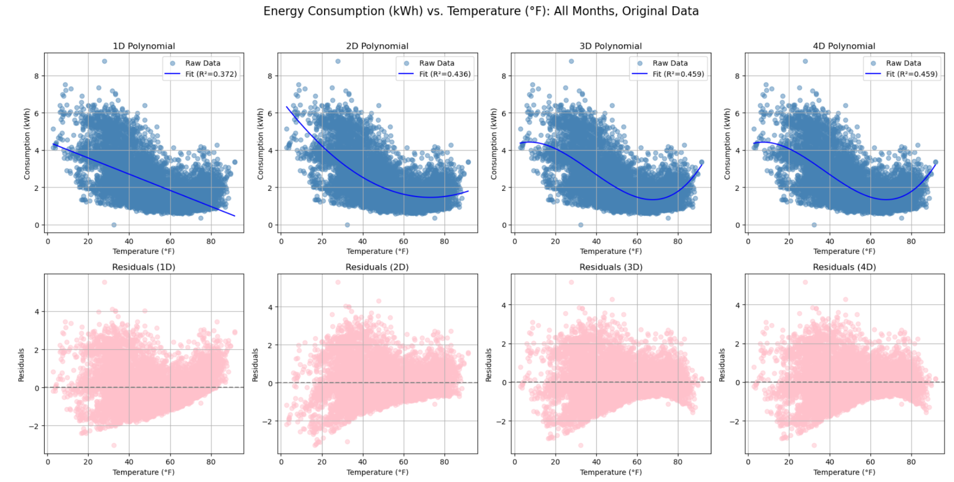
# Consumption (kWh) vs. Temperature (°F)
[All Months, Non-Aggregated]
—--------------------------------------------------------------------------------------
0.372 0.436 0.459 0.459
Poor Fit →

Slide 21
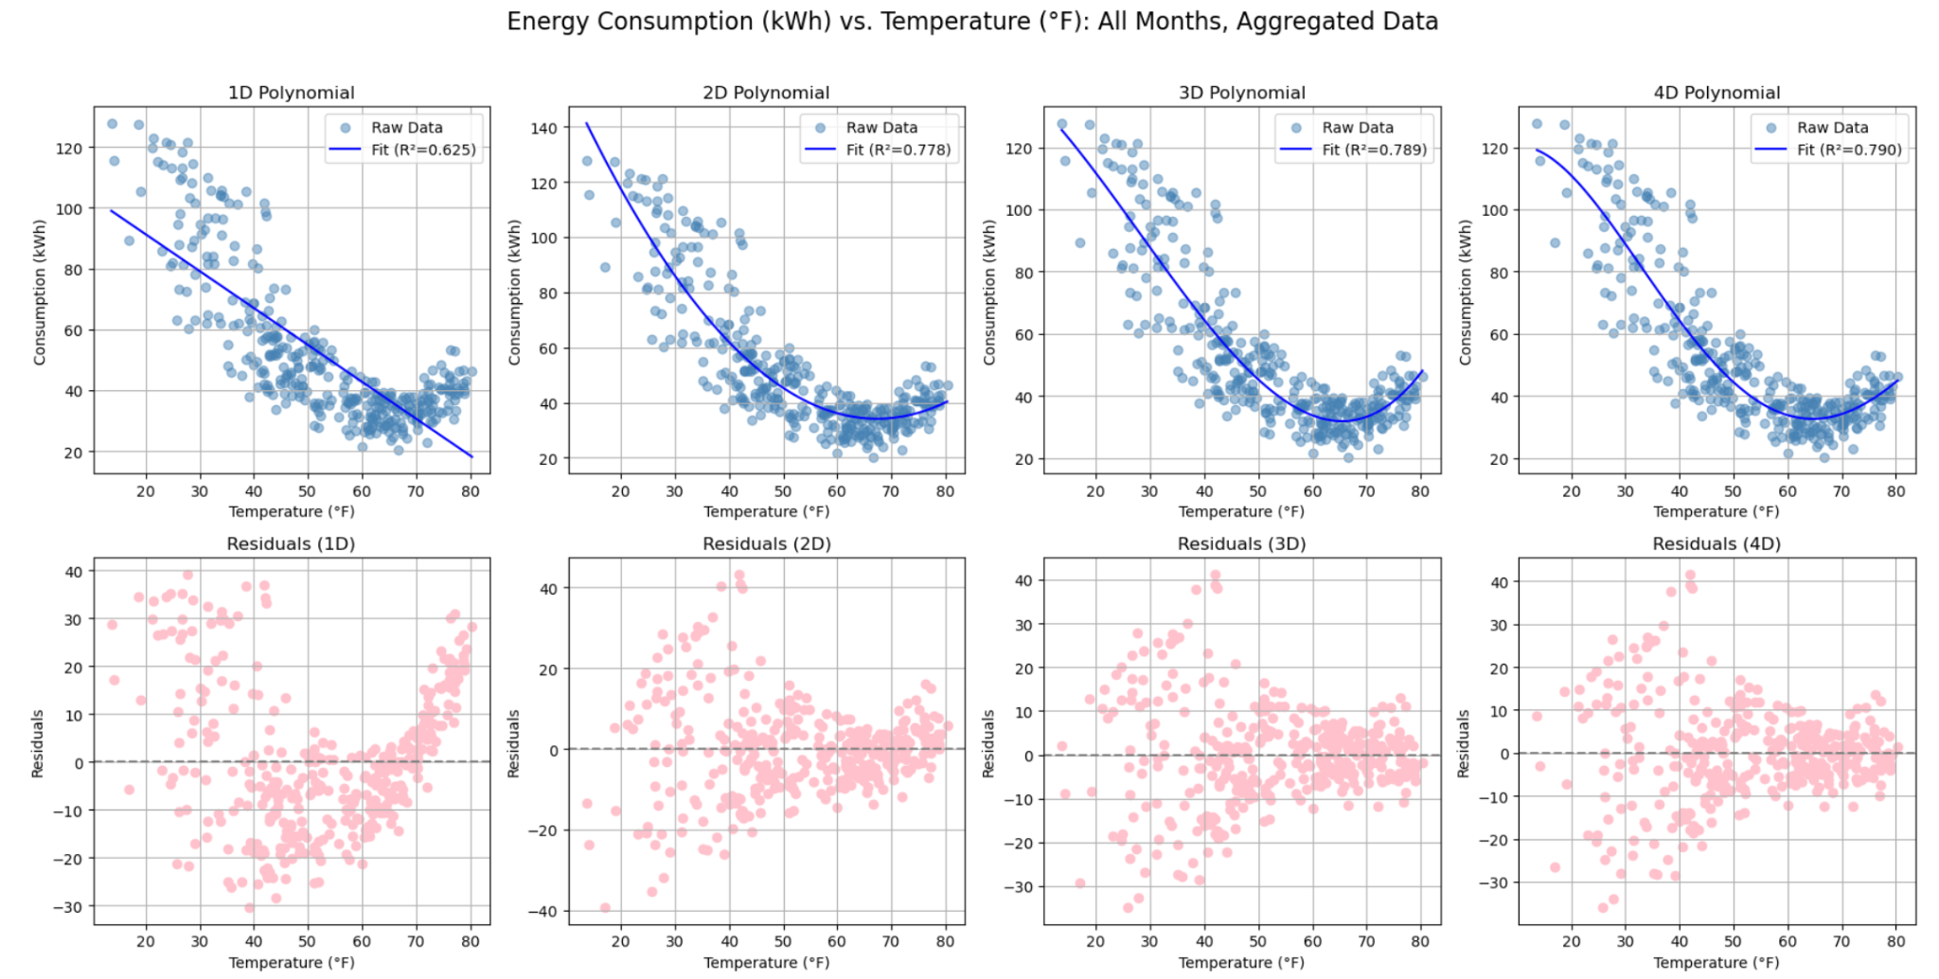
# Consumption (kWh) vs. Temperature (°F)
[All Months, Aggregated]
—--------------------------------------------------------------------------------------
0.625 0.778 0.789 0.790
Better Fit Overfitting →

Slide 22
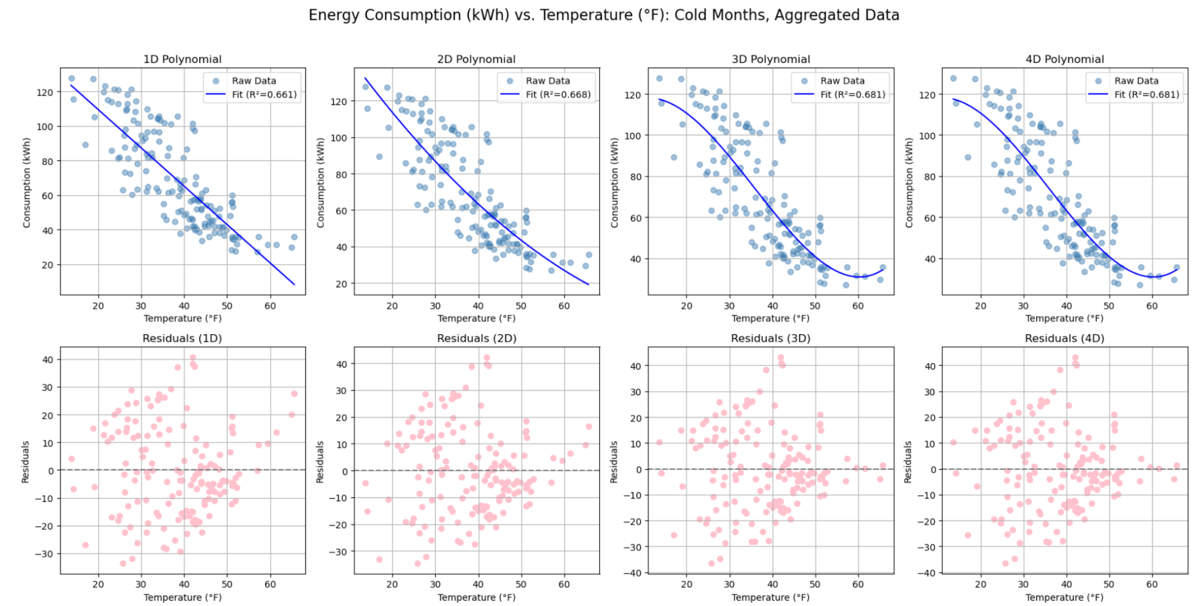
# Consumption (kWh) vs. Temperature (°F)
[Cold Months, Aggregated]
—--------------------------------------------------------------------------------------
0.661 0.668 0.681 0.681
Poor Fit →

Slide 23
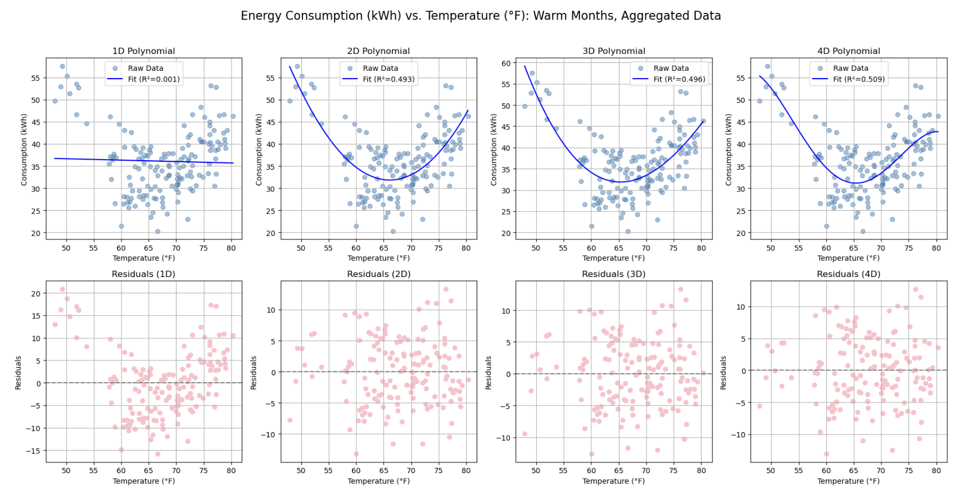
# Consumption (kWh) vs. Temperature (°F)
[Warm Months, Aggregated]
—--------------------------------------------------------------------------------------
0.001 0.493 0.496 0.509
Poor Fit →

Slide 24
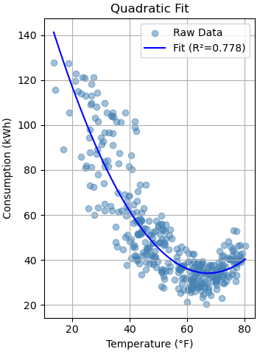
# Consumption (kWh) vs. Temperature (°F)
—--------------------------------------------------------------------------------------
Data | All Months, Aggregated
Best Model | Quadratic
Equation | y = 0.0371 * x² + -5.0025 * x + 202.6014
R² | 0.778
RMSE | 11.52
MAE | 8.307

Slide 25
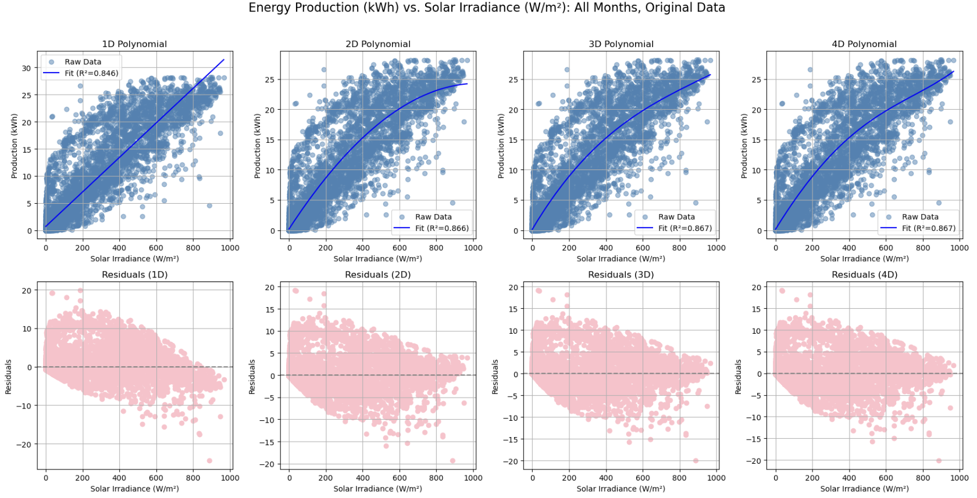
# Production (kWh) vs. Solar Irradiance (W/m²)
[All Months, Non-Aggregated]
—--------------------------------------------------------------------------------------
0.846 0.866 0.867 0.867
Good Fit Overfitting →

Slide 26
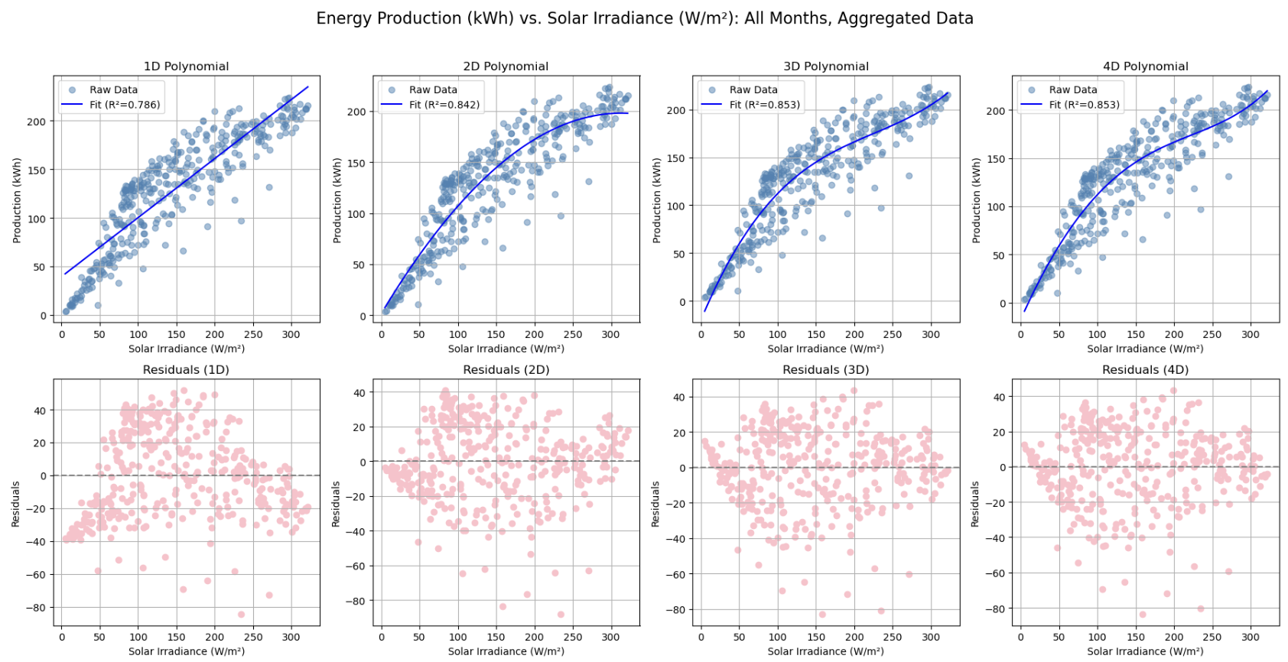
# Production (kWh) vs. Solar Irradiance (W/m²)
[All Months, Aggregated]
—--------------------------------------------------------------------------------------
0.786 0.842 0.853 0.853
Lesser Fit

Slide 27
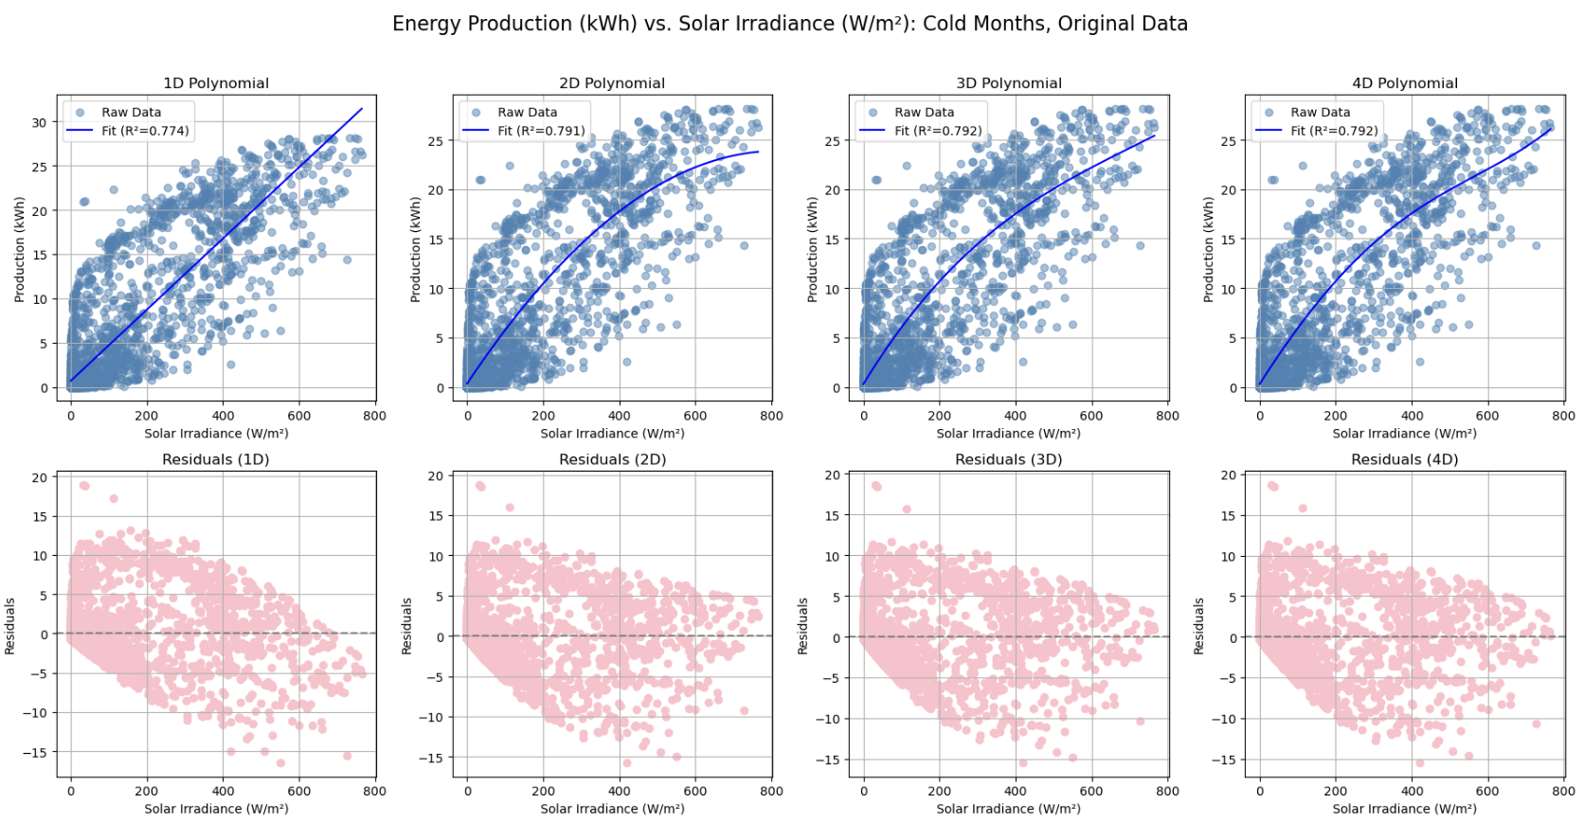
# Production (kWh) vs. Solar Irradiance (W/m²)
[Cold Months, Non-Aggregated]
—--------------------------------------------------------------------------------------
0.774 0.791 0.792 0.792
Poor Fit →

Slide 28
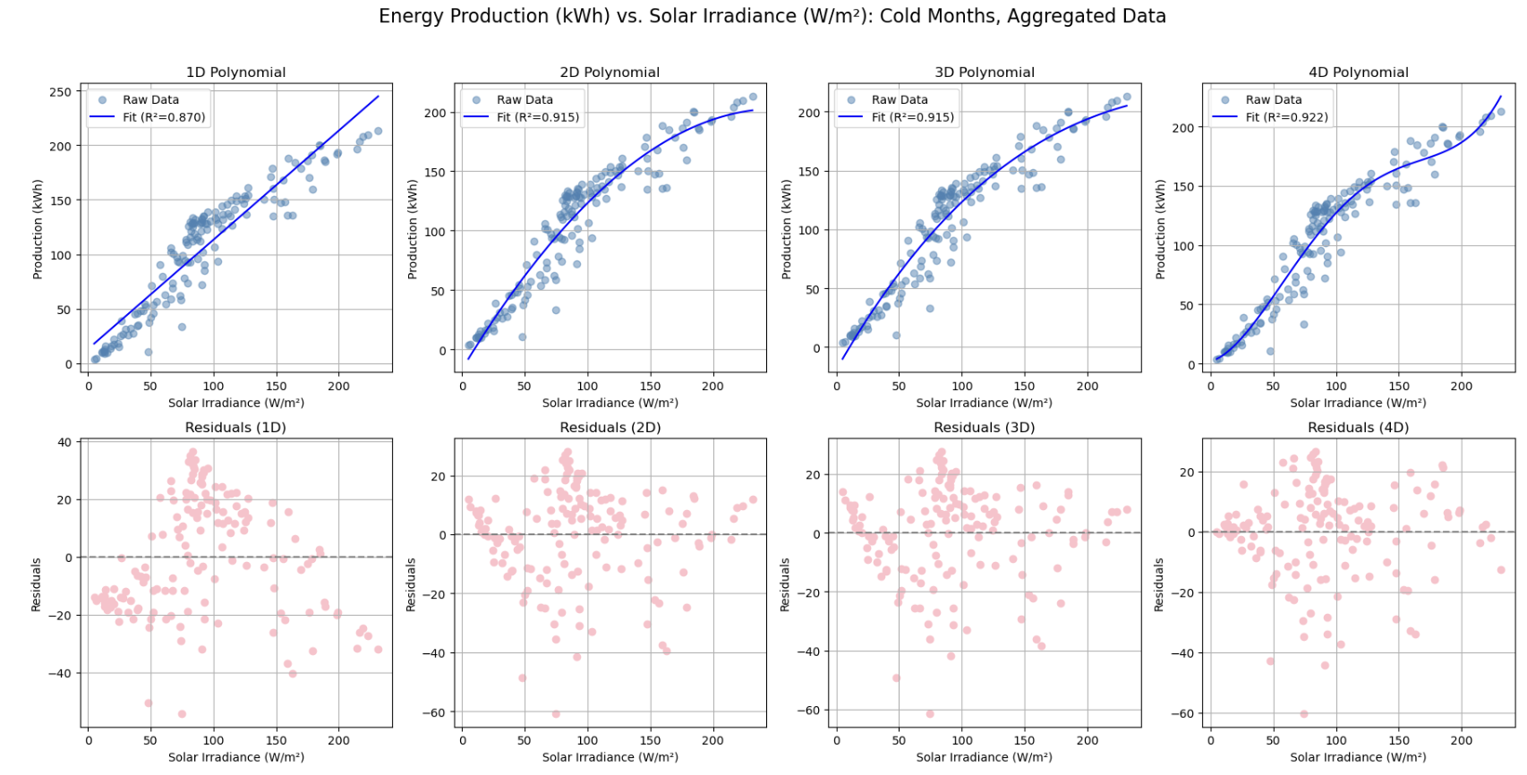
# Production (kWh) vs. Solar Irradiance (W/m²)
[Cold Months, Aggregated]
—--------------------------------------------------------------------------------------
0.870 0.915 0.915 0.922
Good Fit Overfitting →

Slide 29
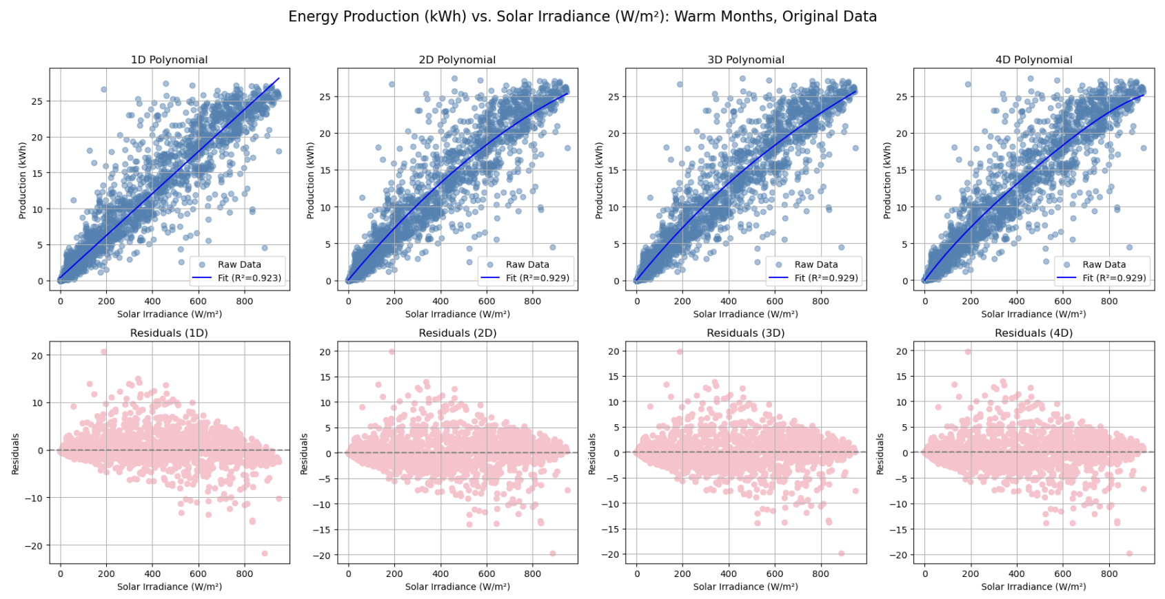
# Production (kWh) vs. Solar Irradiance (W/m²)
[Warm Months, Non-Aggregated]
—--------------------------------------------------------------------------------------
0.923 0.929 0.929 0.929
Good Fit Overfitting →

Slide 30
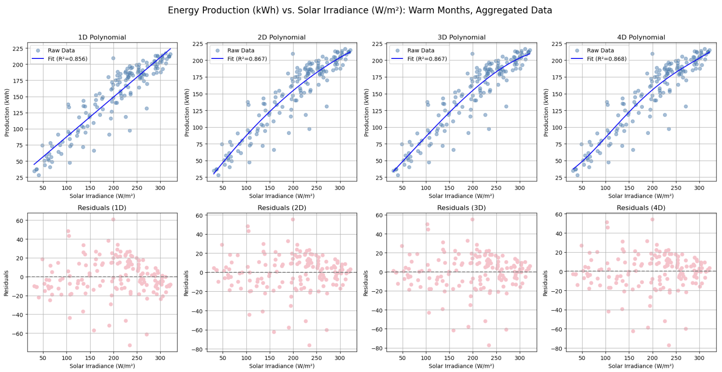
# Production (kWh) vs. Solar Irradiance (W/m²)
[Warm Months, Aggregated]
—--------------------------------------------------------------------------------------
0.856 0.867 0.867 0.868
Lesser Fit

Slide 31
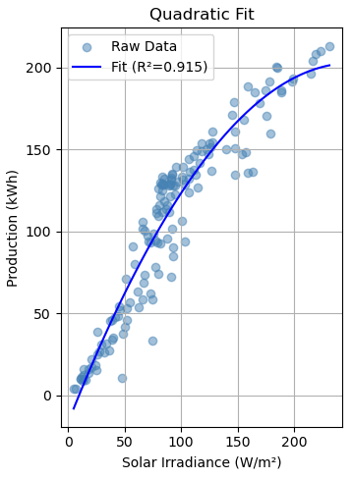
# Production (kWh) vs. Solar Irradiance (W/m²)
—--------------------------------------------------------------------------------------
Data | Cold Months, Aggregated
Best Model | Quadratic
Equation | y = -0.0035 * x² + 1.7463 * x + -16.6515
R² | 0.915
RMSE | 16.25
MAE | 12.57

Slide 32
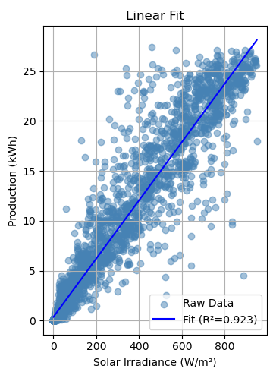
# Production (kWh) vs. Solar Irradiance (W/m²)
—--------------------------------------------------------------------------------------
Data | Warm Months, Non-Aggregated
Best Model | Linear
Equation | y = 0.0292 * x + 0.3607
R² | 0.923
RMSE | 2.310
MAE | 1.271

Slide 33
04
Conclusions & Future Work

Slide 34
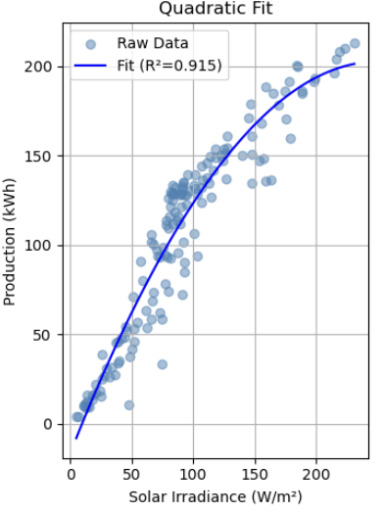
# Conclusions
—--------------------------------------------------------------------------------------
Cons (kWh) vs. Temp (°F)
All months
Aggregated
Quadratic Fit
Prod (kWh) vs. Solar (W/m²)
Cold Months
Aggregated
Quadratic Fit
Warm Months
Non-aggregated
Linear

Slide 35

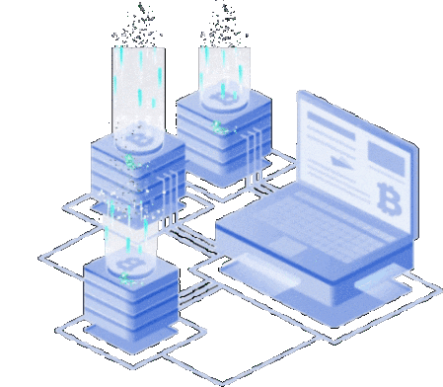
# Future Work
—--------------------------------------------------------------------------------------
Applying energy/weather models to microgrid control system algorithms
Training algorithms to write custom models based on observed system behavior

Slide 36
# THANK YOU
—--------------------------------------------------------------------------------------
Questions?

Slide 37
# References
—------------------------------------------------------------------------------------
https://www.energy.gov/sites/default/files/2024-02/46060_DOE_GDO_Microgrid_Overview_Fact_Sheet_RELEASE_508.pdf
https://www.naseo.org/issues/electricity/microgrids
https://www.shinnecock-nsn.gov/
https://www.enfsolar.com/Product/pdf/Crystalline/559a2d162d49e.pdf
https://enlighten.enphaseenergy.com/web/4881367/today/graph/hours?v=3.4.0
https://www.solarinsure.com/what-does-enphase-enlighten-do
https://tech-stack.com/blog/microgrid-optimization/
https://www.cretechnology.com/en/blog/microgrid-controller/
https://www.visualcrossing.com/weather-query-builder/

